Slide 1
Device Shift
March/April

Slide 2
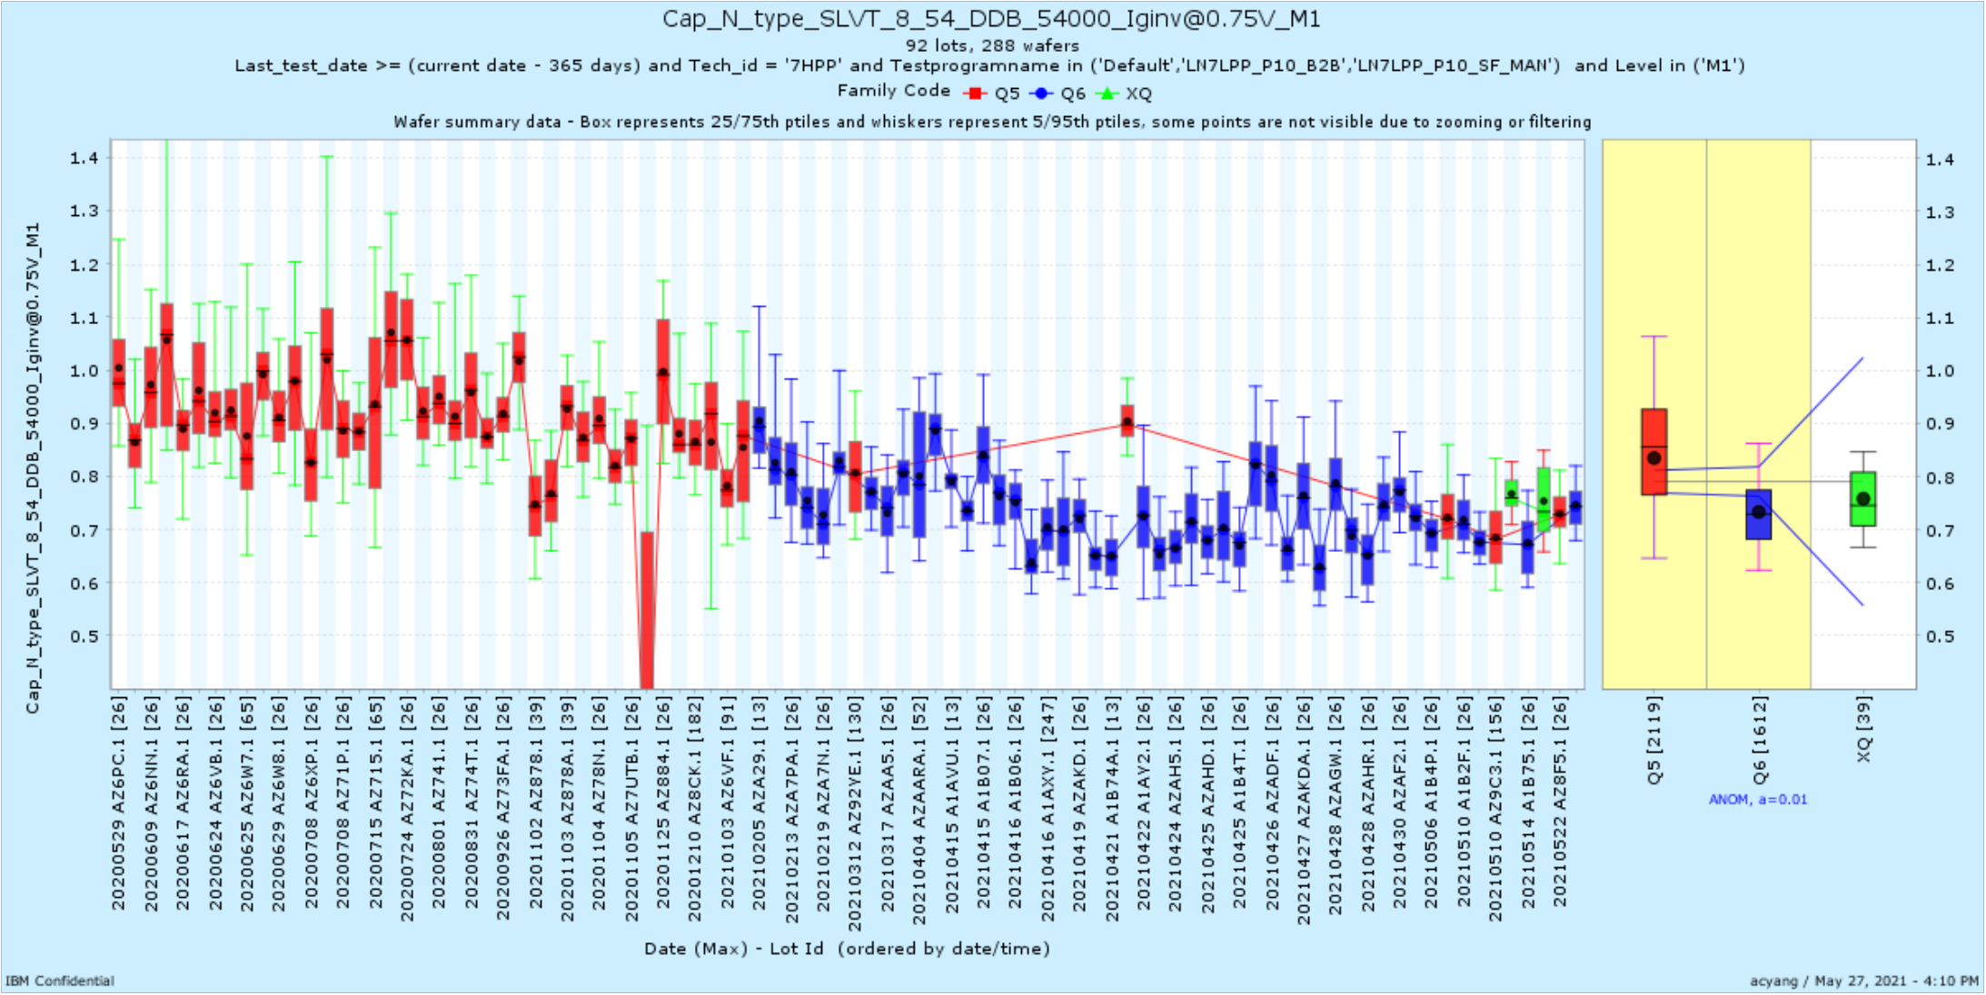
Cap_N_type_SLVT_8_54_DDB_54000_Iginv@0.75V_M1 | AZAAD | 3/15/21 | Device
Cap_P_type_SLVT_8_54_DDB_54000_Iginv@1V_M1 | AZAAD | 3/15/21 | Device
DLW_N_EG_150_230_DDB_4_Ioffd@1.8V_M1 | AZAAD | 3/15/21 | Device
DLW_N_EG_200_280_DDB_4_Ihigh@1.8V_M1 | AZAAD | 3/15/21 | Device
CAP_P_ULVT_4_150_230_7700_Ij_M1 | AZAAD | 3/15/21 | Device
CAP_P_LVT_20_200_280_LB_20400_Ij_M1 | AZAAD | 3/15/21 | Device

Slide 3
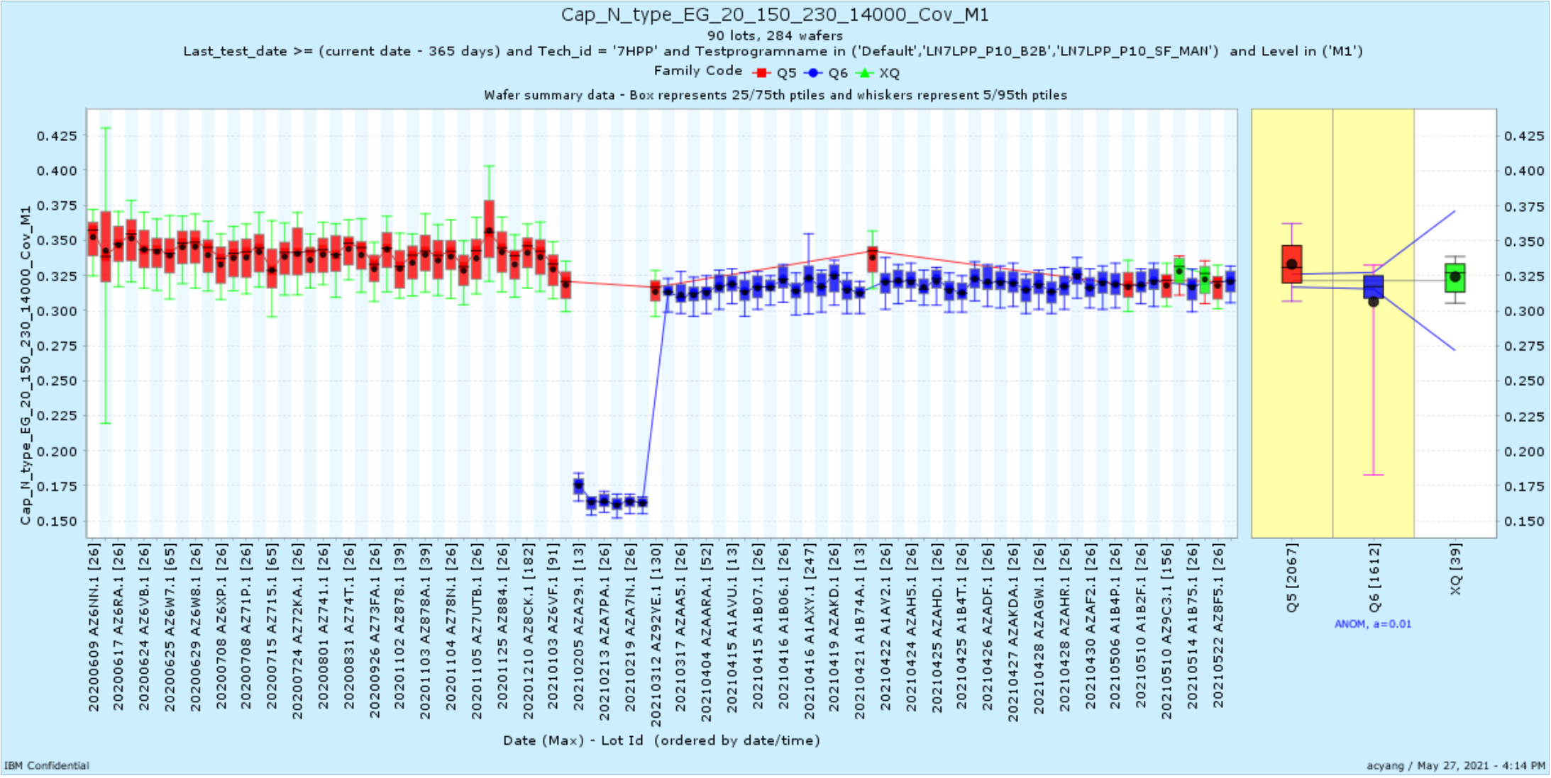
Cap_N_type_EG_20_150_230_14000_Cinv@1.8V_M1 | AZAA5 | 3/17/21 | Device
Cap_N_type_EG_20_150_230_14000_Cov_M1 | AZAA5 | 3/17/21 | Device
Cap_P_type_EG_20_150_230_14000_Cinv@1.8V_M1 | AZAA5 | 3/17/21 | Device
Cap_P_type_EG_20_150_230_14000_Cov_M1 | AZAA5 | 3/17/21 | Device

Slide 4
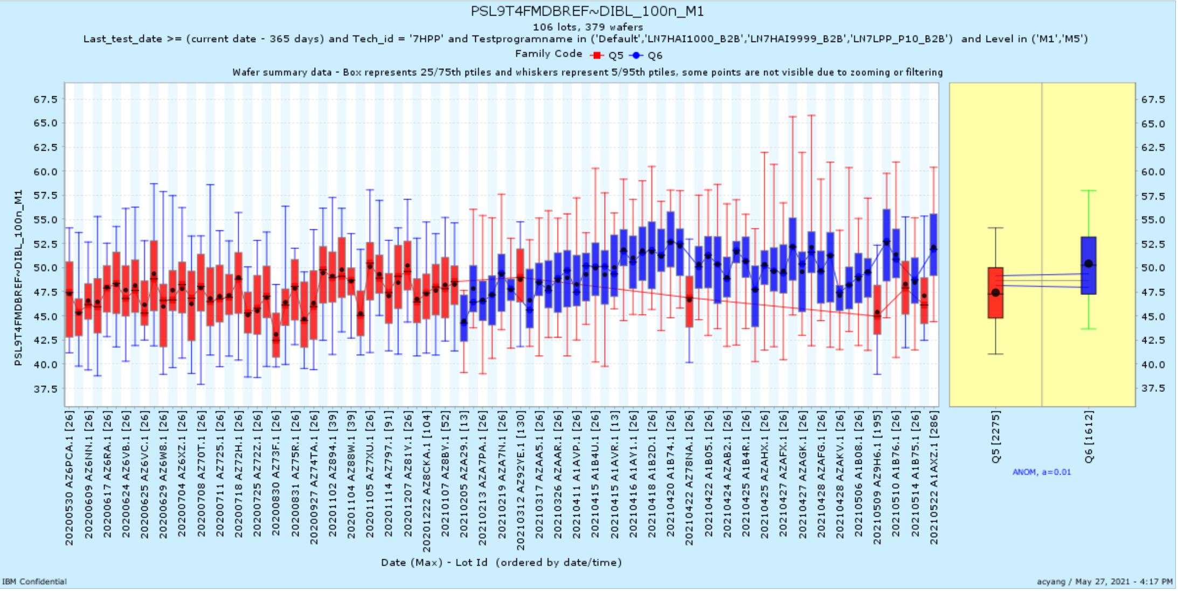
PSL9T4FMDBREF~DIBL_100n_M1 | AZAAR | 3/26/21 | Device

Slide 5
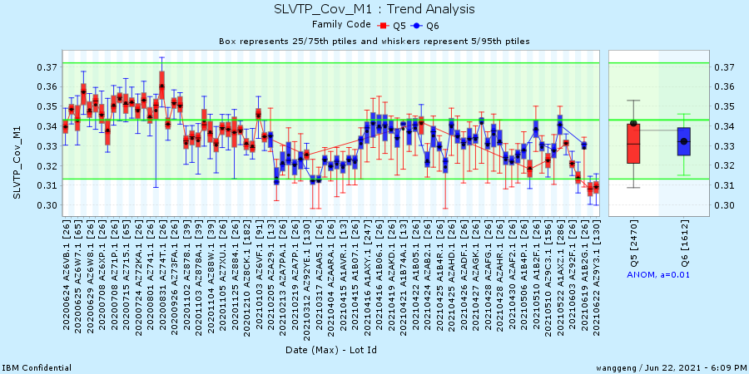

Slide 6
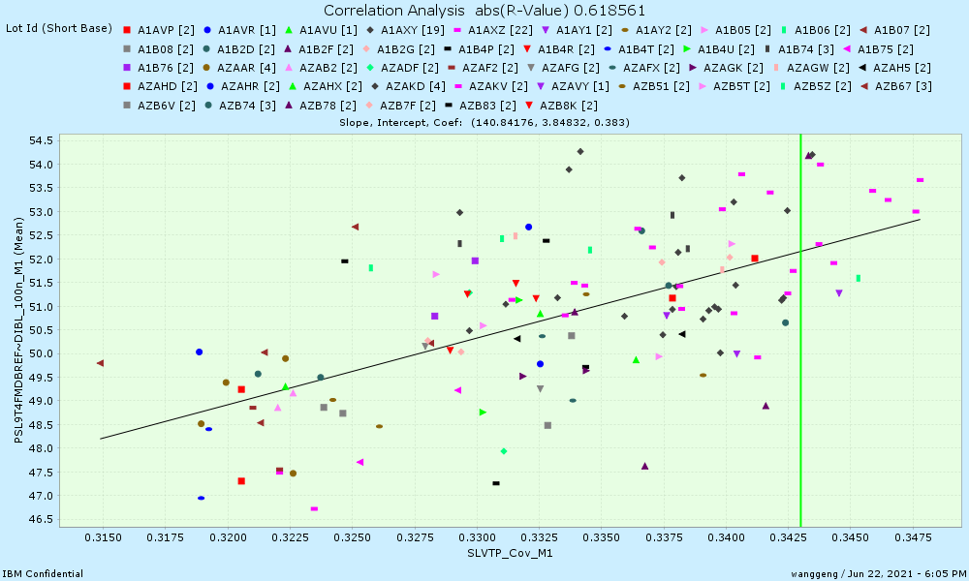

Slide 7
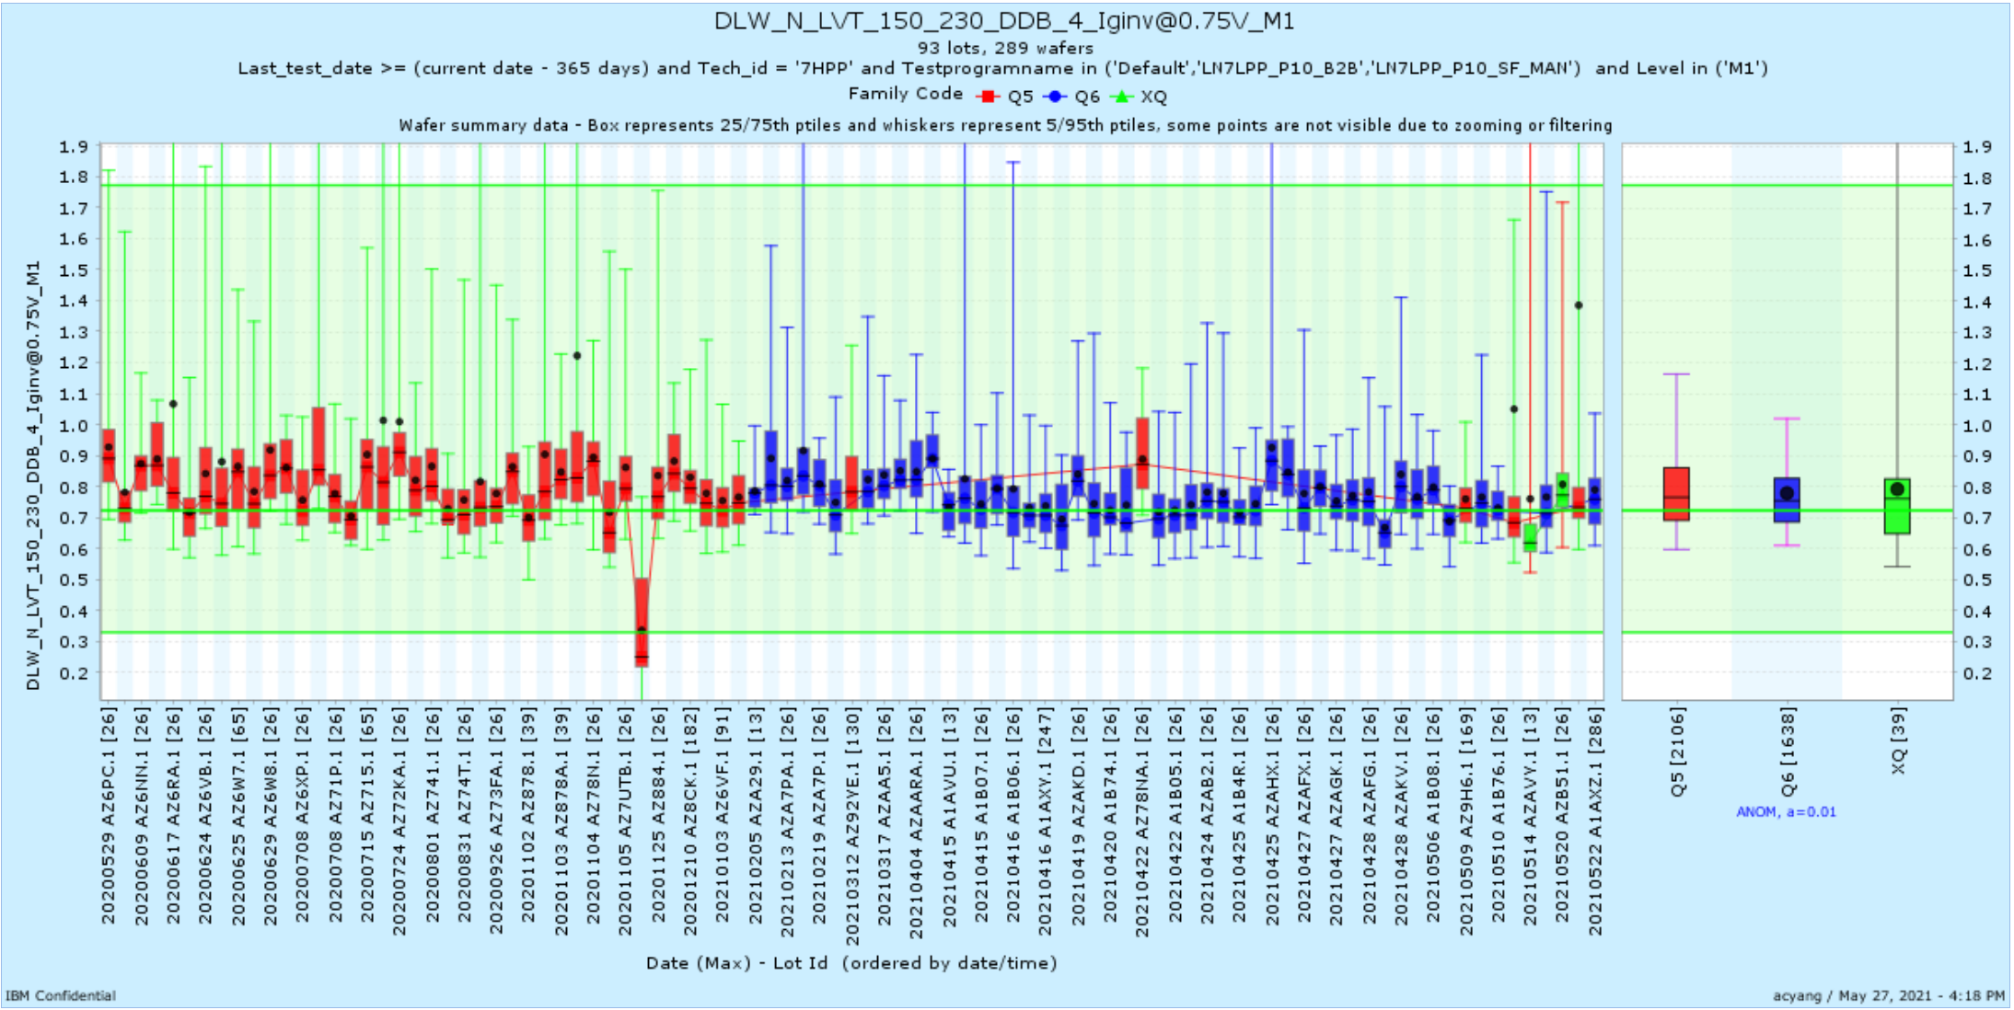
Cap_N_type_LVT_20_200_280_20400_Iginv@1V_M1 | A1AVU | 4/15/21 | Device
DLW_N_LVT_150_230_DDB_4_Iginv@0.75V_M1 | A1AVU | 4/15/21 | Device
DLW_N_EG_200_280_DDB_4_Idsat@1.8V_M1 | A1AVU | 4/15/21 | Device
PUL9T4FMDBREF~DIBL_100n_M1 | A1B4U | 4/15/21 | Device

Slide 8
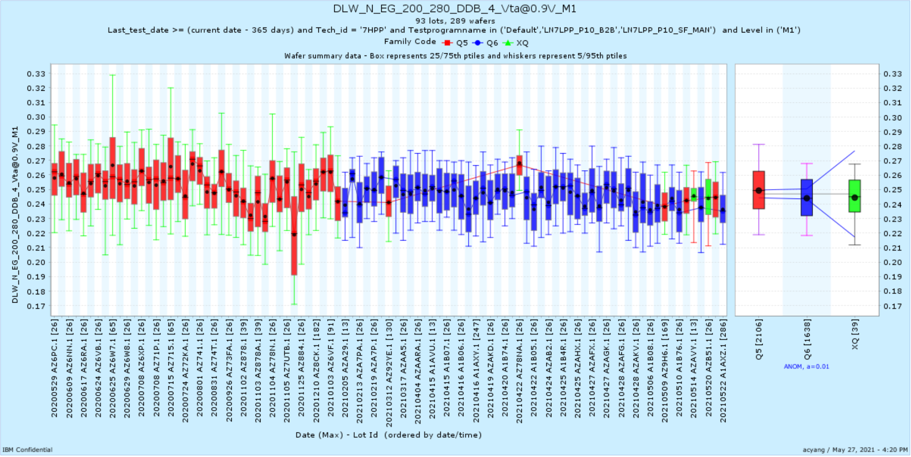
DLW_N_EG_200_280_DDB_4_Vta@0.9V_M1 | AZAF2 | 4/30/21 | Device
DLW_N_EG_200_280_DDB_4_Vtsat@1.8V_M1 | AZAF2 | 4/30/21 | Device

Slide 9
FEOLMOL_HOL Shifts
March/April

Slide 10
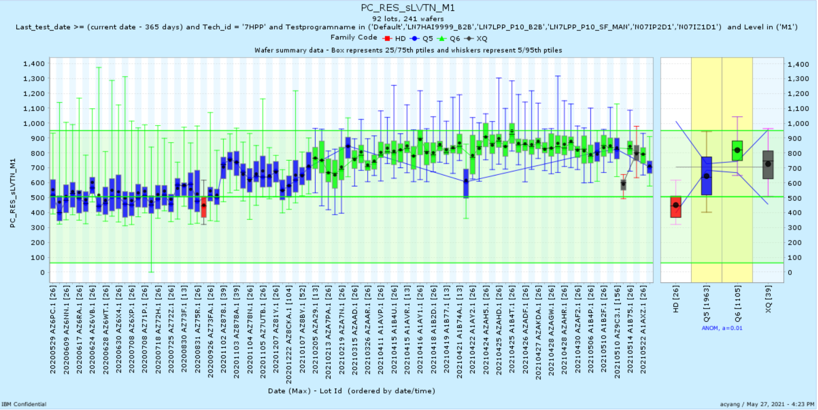
PC_RES_sLVTN_M1 | AZAAR | 3/26/21 | FEOLMOL_HOL
CA_RES_P_onRX_M1 | AZAAR | 3/26/21 | FEOLMOL_HOL
PC_RES_ULVTN_M1 | AZAAR | 3/26/21 | FEOLMOL_HOL

Slide 11
SRAM Shifts
March/April

Slide 12
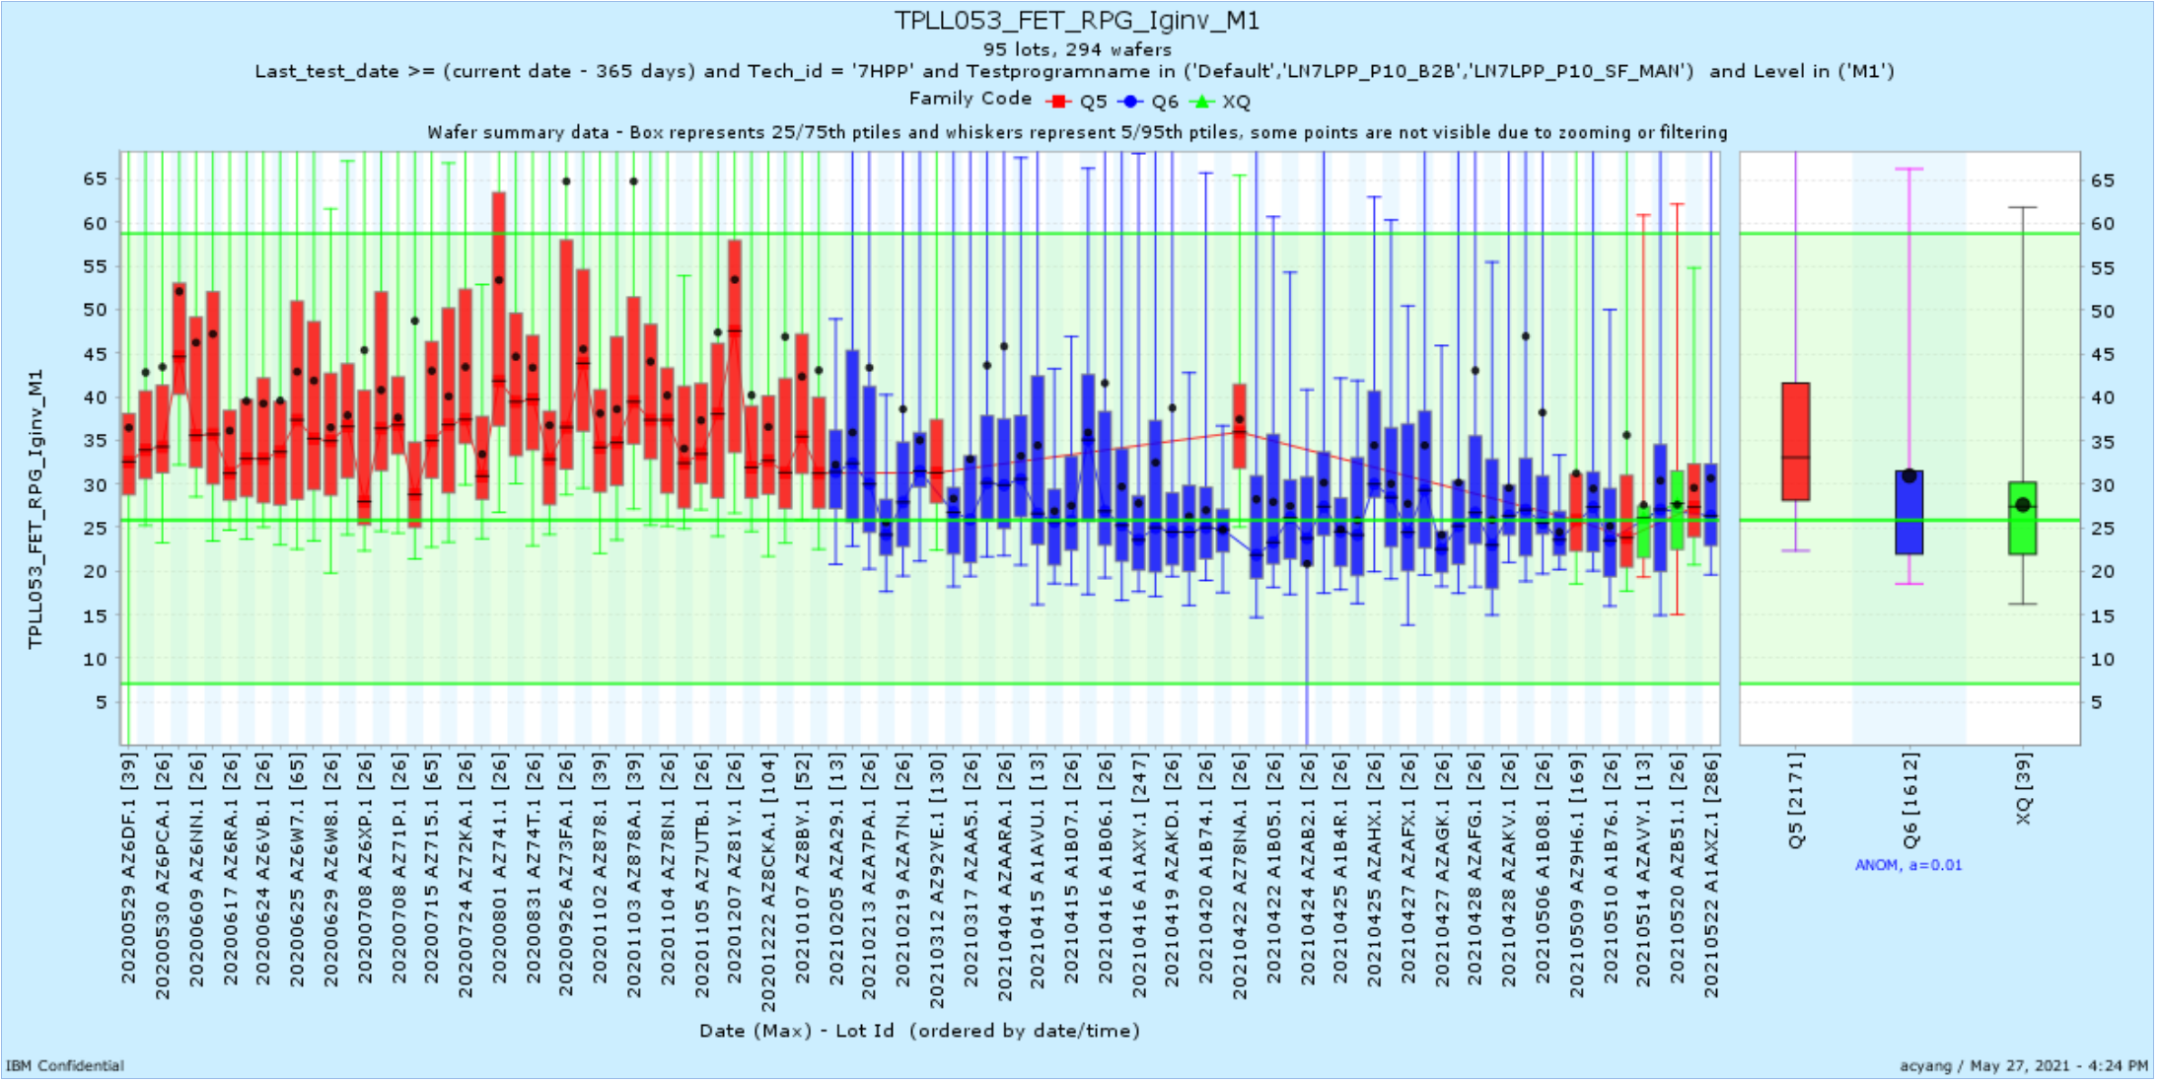
TPLL053_FET_RPG_Iginv_M1 | A1AVP | 4/11/21 | SRAM

